Slide 1

music

Slide 2
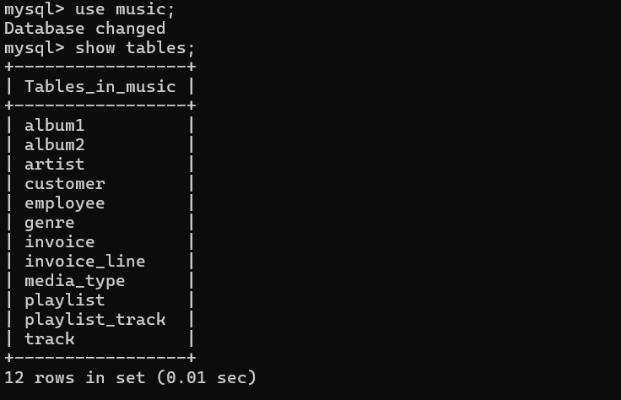
MUSIC
Database & table

Slide 3
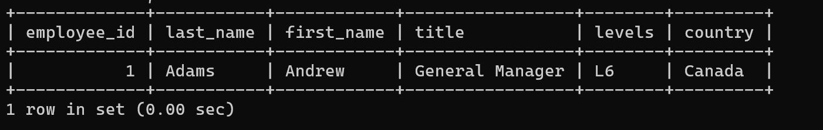
MUSIC
Q1:
Who is the senior most employee based on job title?
→
SELECT employee_id, last_name, first_name, title, levels, country FROM employee
ORDER BY Levels DESC
LIMIT 1;

Slide 4

MUSIC
Q2:
Which countries have the most Invoices?
→
SELECT COUNT(*) AS k, billing_country
FROM invoice
GROUP BY billing_country
ORDER BY k DESC LIMIT 1;

Slide 5
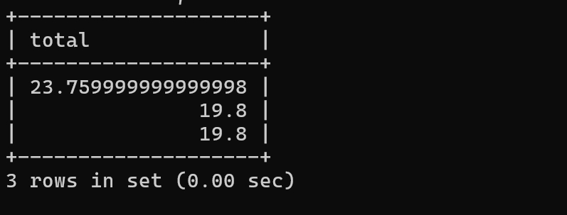
MUSIC
Q3:
What are top 3 values of total invoice?
→
SELECT total FROM invoice
ORDER BY total DESC
LIMIT 3;

Slide 6
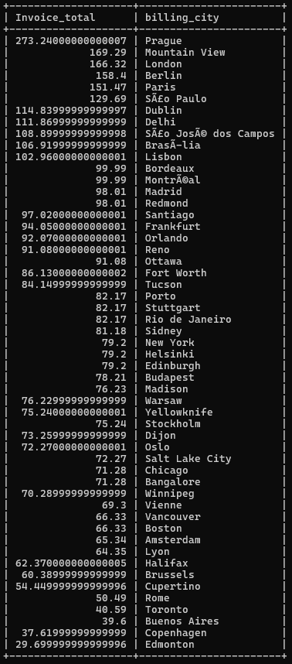
MUSIC
Q4:
Which city has the best customers? We would like to throw apromotional Music Festival in the city we made the most money. Write aquery that returns one city that has the highest sum of invoice totals.Return both the city name & sum of all invoice totals?
→
SELECT SUM(total)AS Invoice_total, billing_city FROM invoice
GROUP BY billing_city
ORDER BY invoice_total DESC;

Slide 7
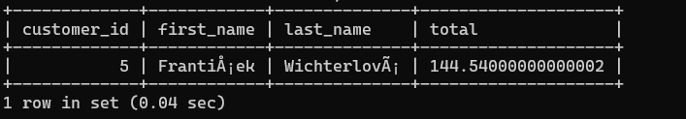
MUSIC
Q5:
Who is the best customer? The customer who has spent the mostmoney will be declared the best customer. Write a query that returnsthe person who has spent the most money.
SELECT customer.customer_id, customer.first_name, customer.last_name, SUM(invoice.total) AS total
FROM customer
INNER JOIN
invoice ON customer.customer_id = invoice.customer_id
GROUP BY
customer.customer_id, customer.first_name, customer.last_name
ORDER BY total DESC LIMIT 1;

Slide 8
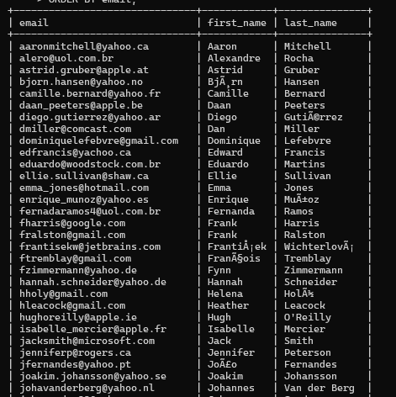
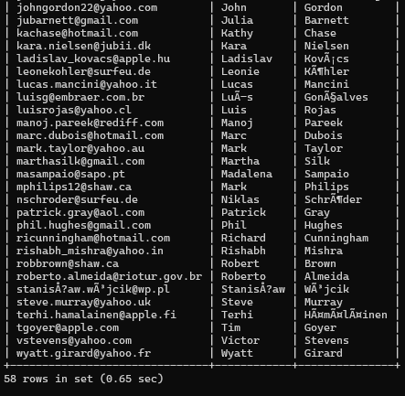
MUSIC
Q6:
Write query to return the email, first name, last name, & Genre of all Rock Music listeners. Return your list ordered alphabetically by email starting with A.
→SELECT DISTINCT email,first_name, last_name FROM customer
INNER JOIN invoice ON customer.customer_id = invoice.customer_id
INNER JOIN invoice_line ON invoice.invoice_id = invoice_line.invoice_id
WHERE track_id IN(
SELECT track_id FROM track
INNER JOIN genre ON track.genre_id = genre.genre_id
WHERE genre.name LIKE 'Rock’)
ORDER BY email;

Slide 9
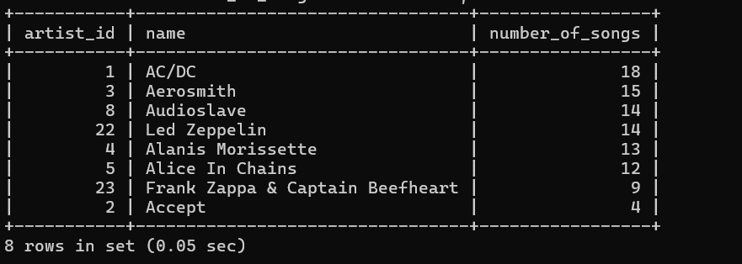
MUSIC
Q7:
Let's invite the artists who have written the most rock music inour dataset. Write a query that returns the Artist name and totaltrack count of the top 10 rock bands?
→ SELECT artist.artist_id, artist.name, COUNT(track.track_id) AS number_of_songs
FROM track
INNER JOIN album1 ON album1.album_id = track.album_id
INNER JOIN artist ON artist.artist_id = album1.artist_id
INNER JOIN genre ON genre.genre_id = track.genre_id
WHERE genre.name LIKE 'Rock'
GROUP BY artist.artist_id, artist.name
ORDER BY number_of_songs DESC
LIMIT 10;

Slide 10
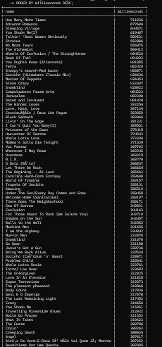
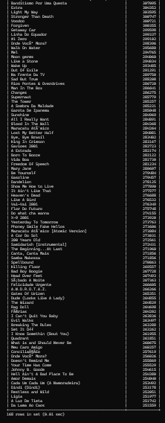
MUSIC
Q8:
Return all the track names that have a song length longer thanthe average song length. Return the Name and Milliseconds foreach track. Order by the song length with the longest songs listedfirst.
→
SELECT name,milliseconds
FROM track
WHERE milliseconds > (
SELECT AVG(milliseconds) AS avg_track_length FROM track)
ORDER BY milliseconds DESC;

Slide 11

Thank you
Krishna B Baraskar

